Slide 1
Lexical resources for processing 17th-century French correspondence with NLP tools
Martin Wynne
Bodleian Libraries, University of Oxford
martin.wynne@bodleian.ox.ac.uk

Slide 2
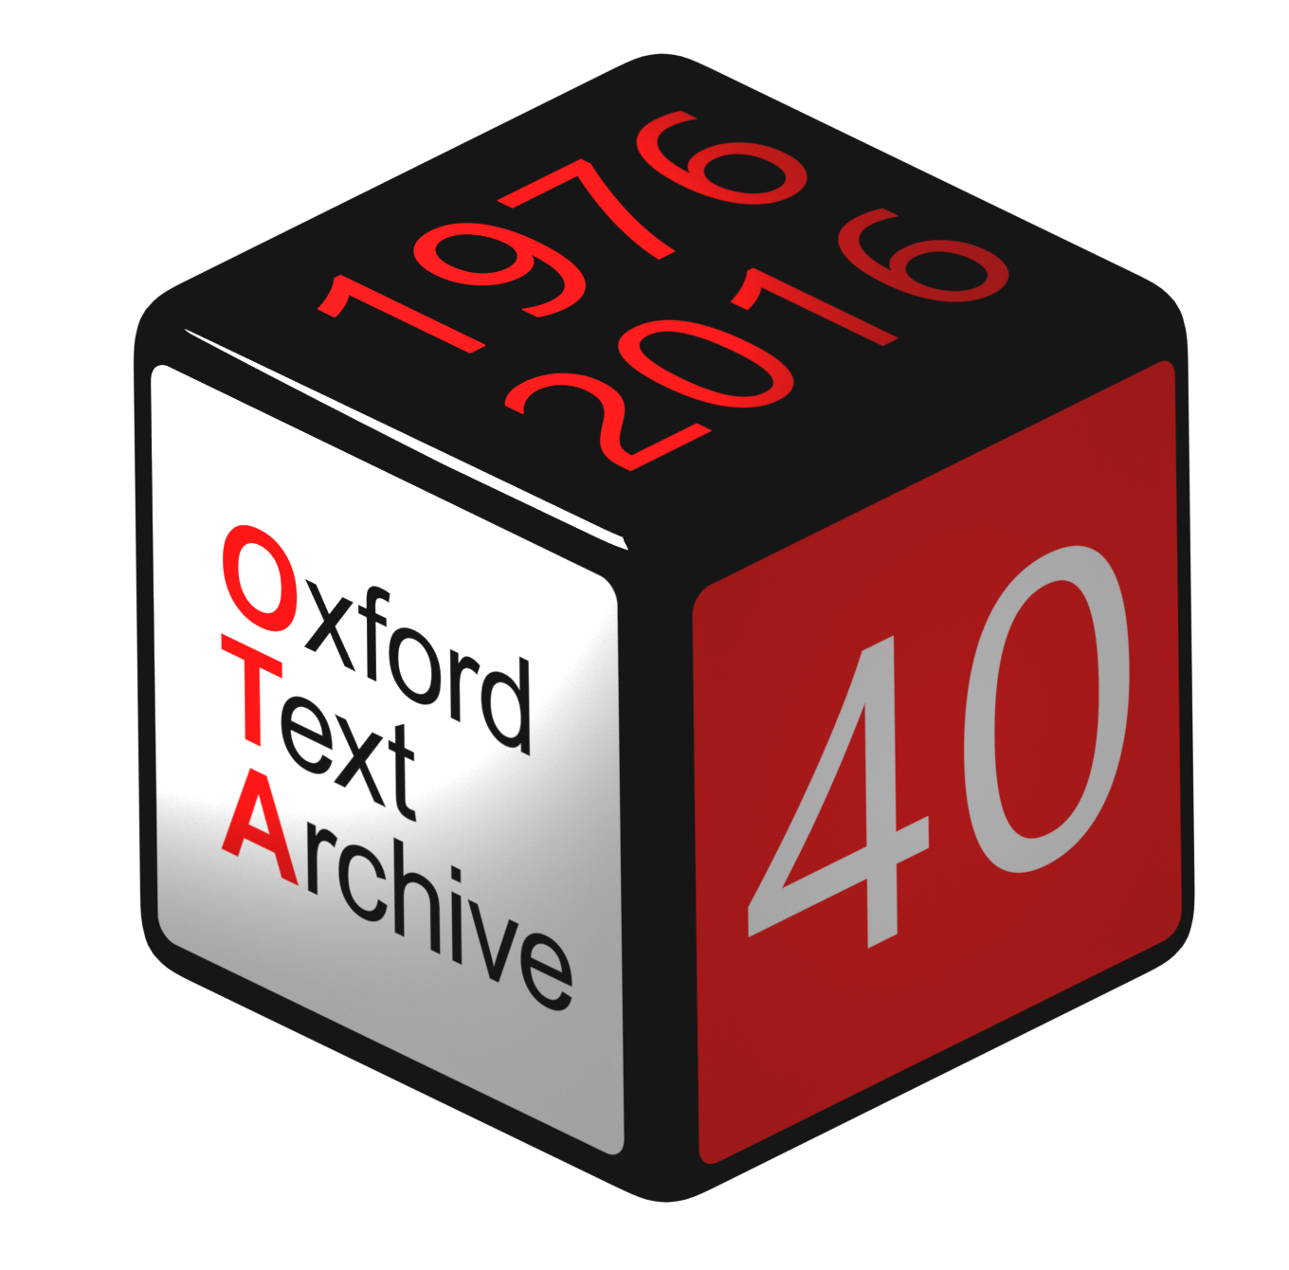
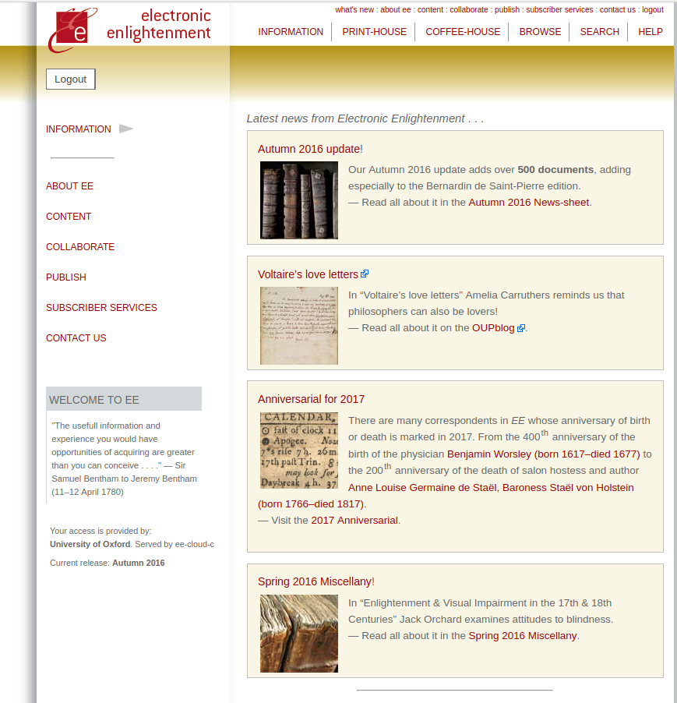
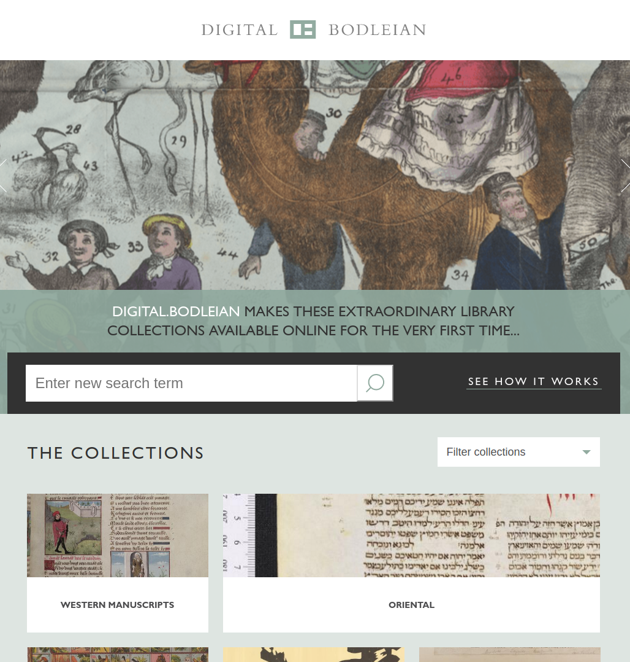



Slide 3
The datasets
Electronic Enlightenment: scholarly digital editions of letters and correspondence.
Collection started with Voltaire & Rousseau, expanded into other Enlightenment (les lumières, die Aufklärung) thinkers and writers, and has expanded into other eras, languages and domains. Now 80 000+ letters, 15 000+ people
A project in the University of Oxford, initially part of the Voltaire Foundation, moved to the Bodleian Libraries in 2008. Access is via institutional subscription managed by Oxford University Press.

Slide 4
The problem
We want to make online search and exploration of our text collections freely available.
In order to search historical French texts effectively, users need to be able to find inflected forms and variant spellings. How can we make that search possible?

Slide 5
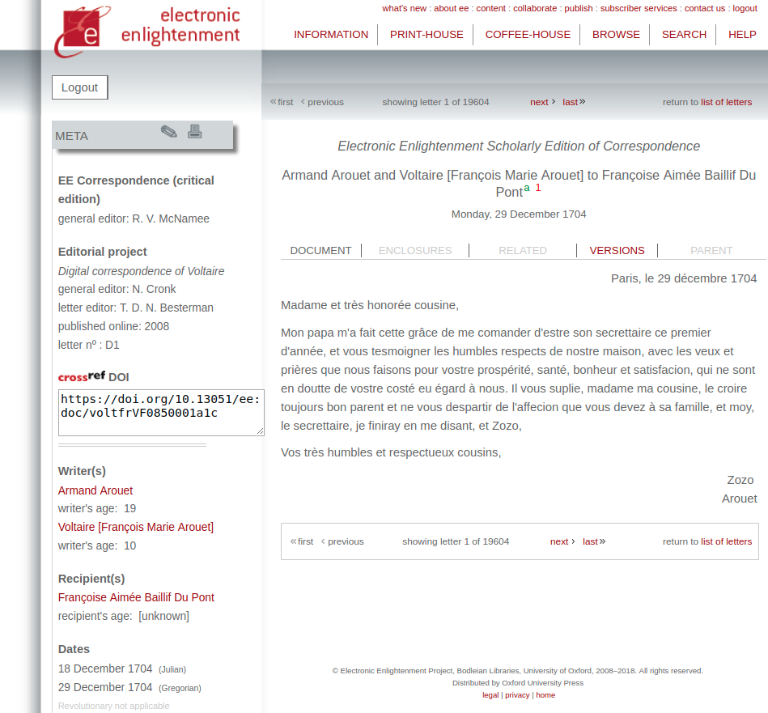

Slide 6
Challenges for modern part-of-speech annotation tools
Mon papa m'a fait cette grâce de me comander d'estre son secrettaire ce premier d'année, et vous tesmoigner les humbles respects de nostre maison, avec les veux et prières que nous faisons pour vostre prospérité, santé, bonheur et satisfacion, qui ne sont en doutte de vostre costé eu égard à nous. Il vous suplie, madame ma cousine, le croire toujours bon parent et ne vous despartir de l'affecion que vous devez à sa famille, et moy, le secrettaire, je finiray en me disant, et Zozo,

Slide 7
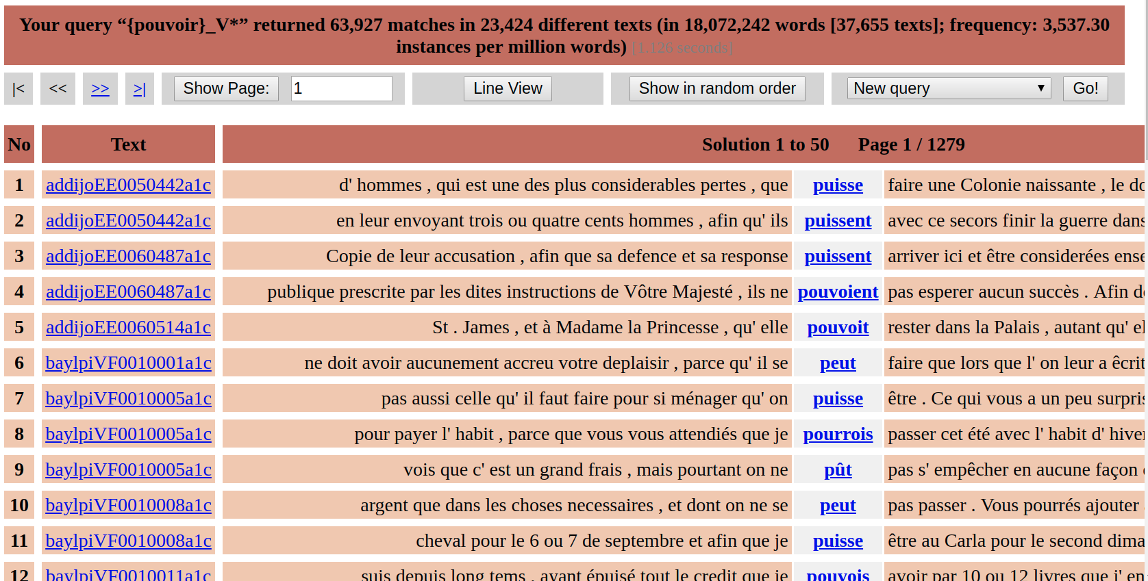
Where we want to get to...for all or most words

Slide 8
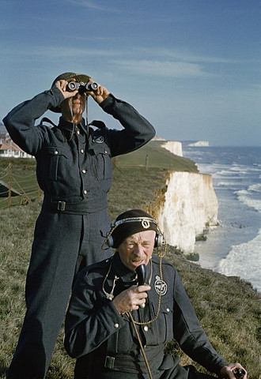
The search for existing resources and prior art
Where are digital texts in French from the 17th and 18th centuries in original spellings?
Where are software applications to work with texts from these periods?
Where are computational lexicons with older variants?

Slide 9
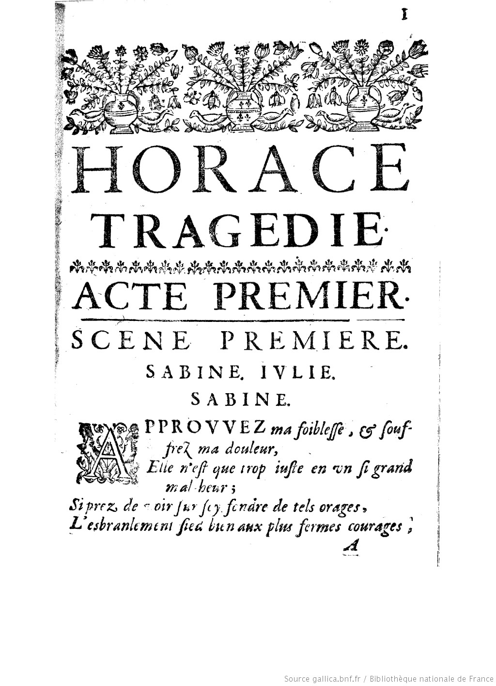
Some preliminary conclusions
Most French digital historical texts in circulation have modernized spellings. (They fail the “Horace-foibleſſe” test – do they have the original “foibleſſe” or the modernized “faiblesse” in the digital text?)
Therefore most software tools have had not had to deal with original spellings.
More research required, but it appears that tools have not been created or adapted to deal with older forms of French.
Notes:
Digital correspondence in EE is based on scholarly editions and almost all has original spellings.

Slide 10
tems | temps | NOM | temps
tete | tête | NOM | tête
theatre | théatre | NOM | théatre
tolerable | tolérable | ADJ | tolérable
tolerance | tolérance | NOM | tolérance
tolerans | tolérants | ADJ | tolérant
tolérans | tolérants | ADJ | tolérant
tolerants | tolérants | ADJ | tolérant
tolerant | tolérant | ADJ | tolérant
tolerence | tolérance | NOM | tolérance
tolérerez | tolérez | VER:futu | tolérer
tolerer | tolérer | VER:infi | tolérer
toleré | toléré | VER:pper | tolérer
tolere | tolére | VER:pres | tolérer
toleroit | tolérait | VER:impf | tolérer
tollerançe | tolérance | NOM | tolérance
tollérance | tolérance | NOM | tolérance

Slide 11
Why the Masterclass?
The previous slide shows our custom lexicon. We want this lexical data to be re-usable , multipurpose, and shared.
Probably people have addressed this problem before, but their lexical resources are not being shared, and can’t be re-used.
In order to share data, expertise and know-how, we want to make a re-usable dictionary of variant forms in 16-19th century French in appropriate formats.
Therefore, we want to be able to transform the data to something like the following slide...

Slide 12
Objective
<entry>
<form type="historical variant">
<orth>tolérans</orth>
<orth>tolerans</orth>
<orth>tollerans</orth>
</form>
<form type="modern normalized equivalent">
<orth>tolérants</orth>
</form>
<form type="lemma">
<orth>tolérant</orth>
<gramGrp>
<pos>ADJ</pos>
<gen>masc</gen>
<num>plural</num>
</gramGrp>
</form>
</entry>

Slide 13
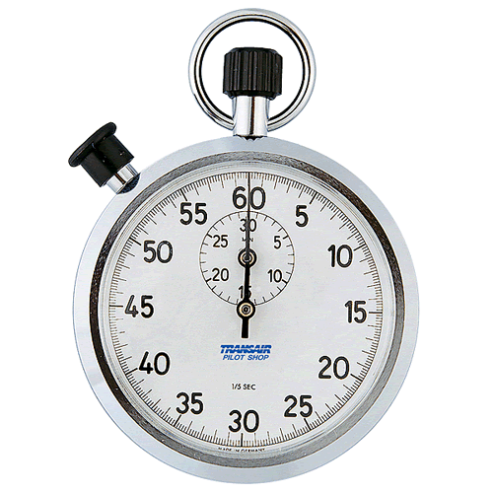
Time’s Up!
About your speaker:
  Name: Martin Wynne
  Institution: University of Oxford
  Social Media: @MartinJWynne
  Quick bio: Degree in French, some experience with German, Spanish, Polish; background in corpus linguistics, digital humanities, digital preservation; worked at Lancaster, Birmingham, IDS Mannheim, Collins Cobuild; UK national coordinator for CLARIN; Bodleian Libraries since 2016.

